Slide 1
Capstone Project - 3 Health Insurance Cross sell Prediction
Created By
Mr. Pritam Gangwar

Slide 2
Content
Introduction
Problem definition
Hypothesis
EDA on given data
Statistical Data Analysis
Model implementation
Model validation and selection
Conclusion
References

Slide 3
Introduction
are being used and the scope of
to land use and
Currently automobiles
transportation and living,
equipment is expanding.
This rapid increase in automobiles has caused automobile insurance to emerge as an essential business target for insurance companies.
Therefore, if the car insurance sales are predicted and sold using the information of existing health insurance customers.

Slide 4
Introduction
It can generate continuous profits in the insurance company's operating performance.
Aim of the project is to put a model on given data for health insurance cross sell prediction.

Slide 5
Problem definition
Building a model to predict whether a customer would be interested in Vehicle Insurance is extremely helpful for the company.
It can then accordingly plan its communication strategy to reach out to those customers and optimise its business m odel and revenue.

Slide 6
Hypothesis Statement
From data and problem statement we would like to put
hypothesis on 5 features as.
Vehicle previously insured will affect Response variable.(If the vehicle is
already insured then no will buy insurance twice.)
Age will not affect Response.(All the vehicle owners no matter what age will buy insurance.)
Driving license will not affect Response.(In general it will not affect)
There will be positive co relation in Vintage and Response.(Old
customers with company will buy insurance.)
Vehicle damage will affect Response.(If the vehicle is damaged
previously owner will definitely buy insurance.)

Slide 7
EDA
Digging into data we understand that
There are total 11 Features such as
Id - Unique ID for the customer
Gender - Gender of the customer
Age - Age of the customer
Driving License - 0: Customer does not have DL, 1: Customer have DL.
Region code - Unique code for the region of the customer.
Previously Insured – 1: customer has already insurance, 0:
customer does not have insurance.

Slide 8
EDA
Vehicle age – Age of the vehicle.
Vehicle damage – 1: customer got his/ her car damage in the past 0: customer didn’t get his/ her car damage in the past
Annual premium – The amount customer needs to pay as a premium in the year.
Policy sales channel – Anonymized code for the channel of outreaching the customer. i.e. Different agents, over mail etc.
Vintage : Number of Days, Customer has been associated with the comp
any
Response variable is :
Response : 1 : Customer is interested, 0 : Customer is not interested

Slide 9
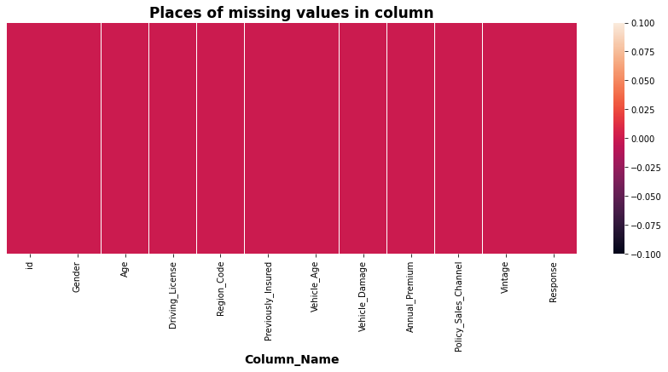
EDA
We can see there is no null values in the given data set.

Slide 10
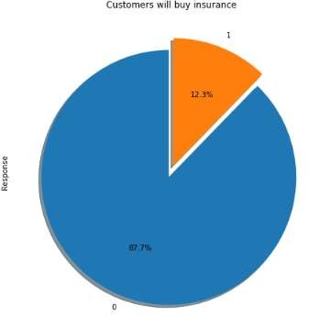
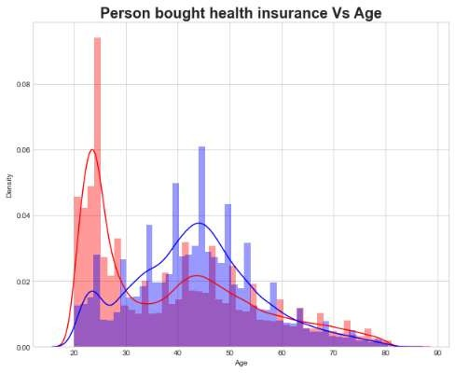
EDA
Pi plot shows percentage of response(Fig 2) and Density plot of age and response(Fig
3).
Fig 2: Pi plot of Response 0 and 1.
Fig 3: Plot of Age vs Response.

Slide 11
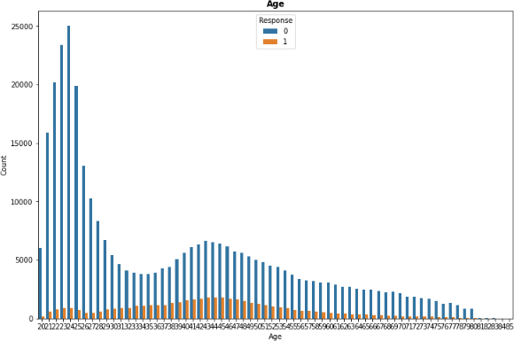
EDA
In the age of 35 to 50 Response count is more.
Fig 4: Age vs Response count.

Slide 12
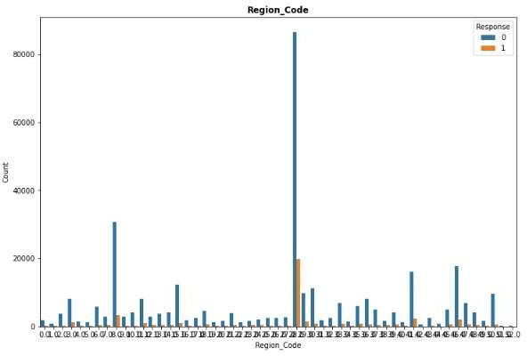
EDA
Region code 29 has more count (0 and 1) for Response.
Fig 5: Region vs Response count.

Slide 13
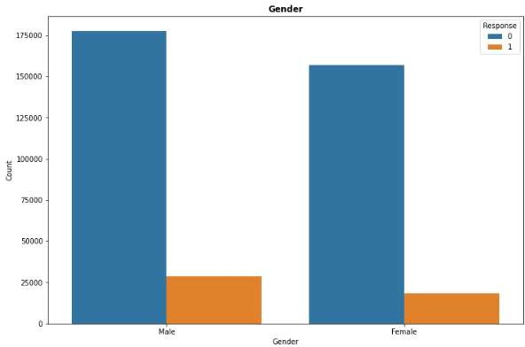
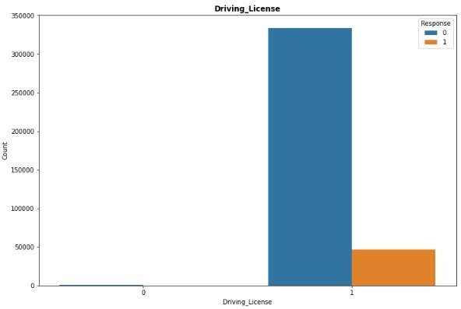
EDA
Gender has no specific impact on Response same condition for Driving license.
Fig 6: Region vs Response count.
Fig 7: Region vs Response count.

Slide 14
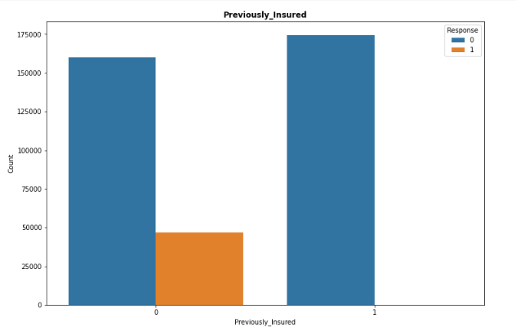
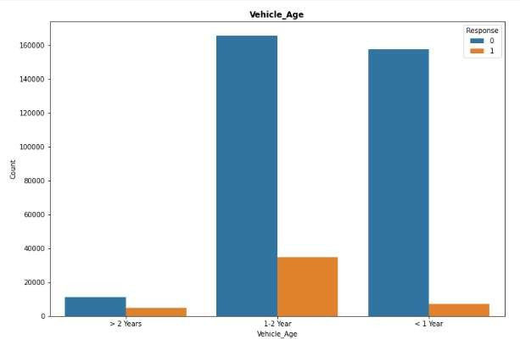
EDA
Previously insured has more impact on Response and Vehicle age between 1-2 years
are more interested in insurance.
Fig 8: Previously insured vs Response count.
Fig 9: Vehicle age vs Response count.

Slide 15
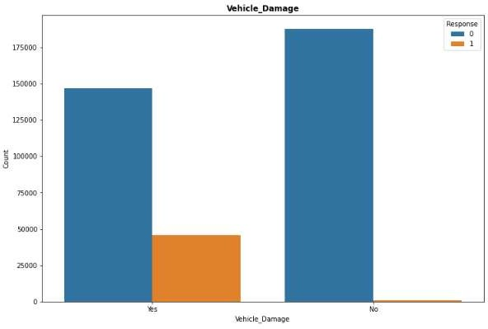
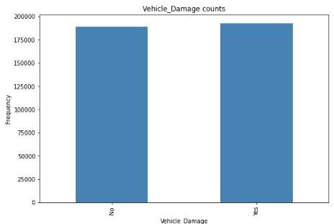
EDA
If Vehicle is damaged then response is 1. There is no much difference in between
vehicle damage yes and no.
Fig 10: Vehicle damage vs Response count.
Fig 11: Vehicle damage vs Frequency.

Slide 16
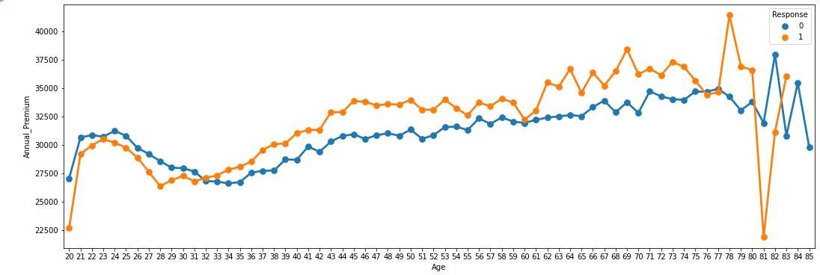
EDA
Age is positively co related with Annual premium.
Fig 12: Age vs Annual premium.

Slide 17
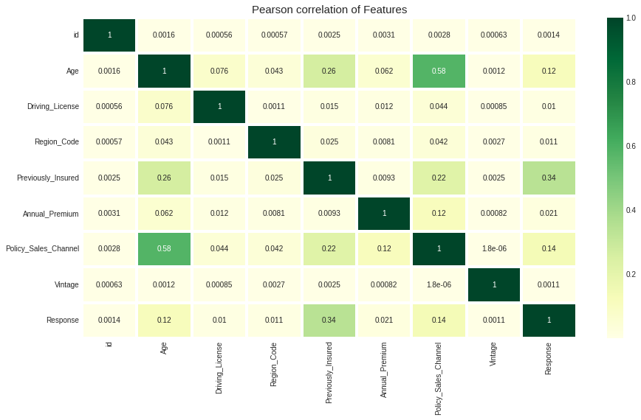
EDA
Fig 13: Heat map of variables

Slide 18
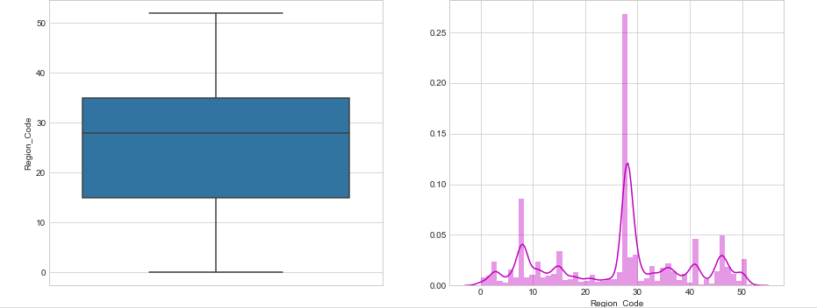
Statistical Data Analysis
Region code is normally distributed and has no outliers.
Fig 14: Distribution of Region code.

Slide 19
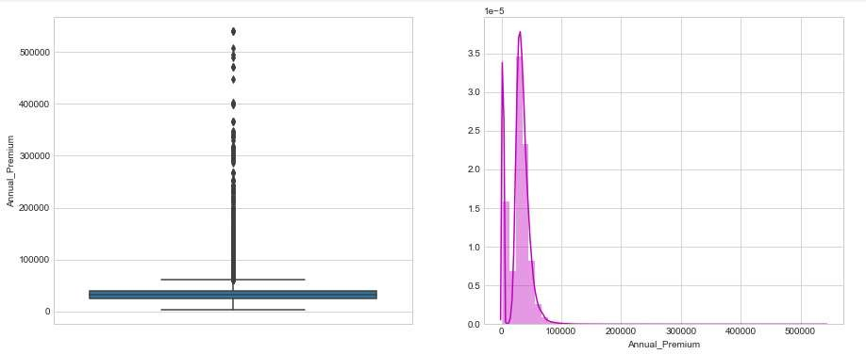
Statistical Data Analysis
Annual premium is positively skewed and has outliers.
Fig 15: Distribution of Annual premium.

Slide 20
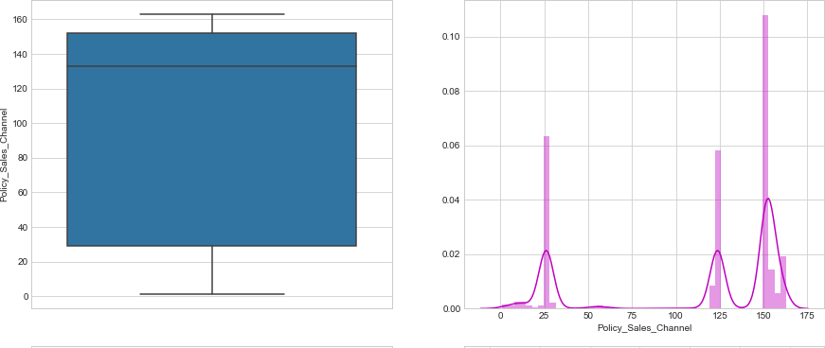
Statistical Data Analysis
Policy sales channel has 3 kurtosis and has no outliers.
Fig 16: Distribution of Policy sales channel.

Slide 21
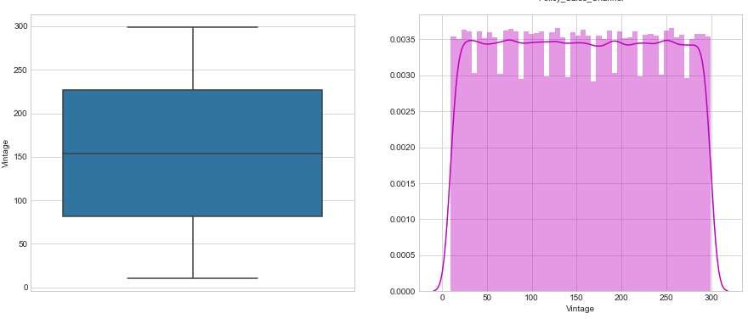
Statistical Data Analysis
Distribution of Vintage customers which has no outliers.
Fig 17: Distribution of Vintage customers.

Slide 22
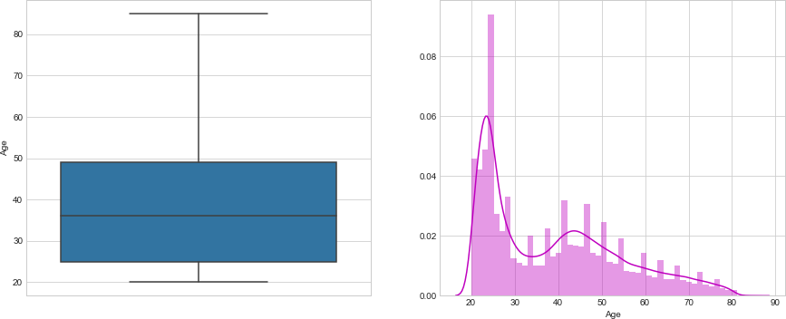
Statistical Data Analysis
Age is positively skewed and has no outliers.
Fig 18: Distribution of Age.

Slide 23
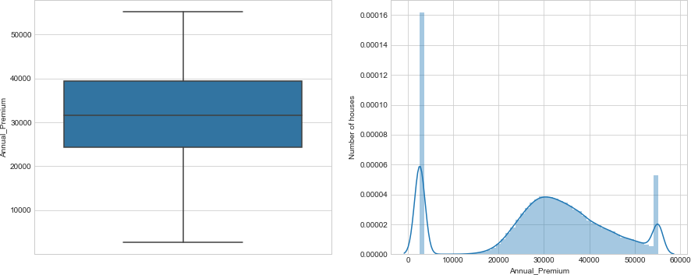
Statistical Data Analysis
Treated Annual premium with removal of outliers .
Fig 19: Treated annual premium

Slide 24
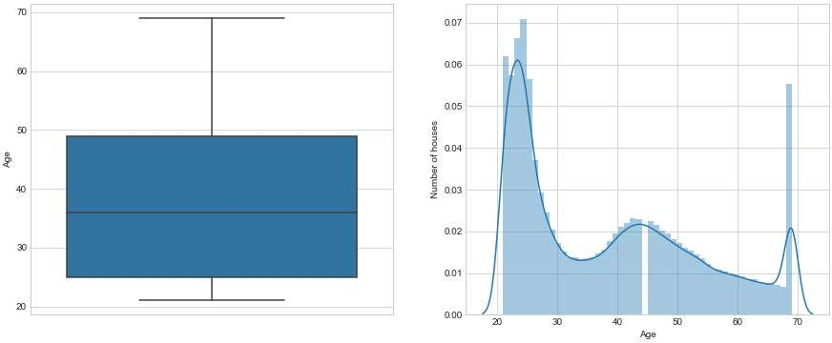
Statistical Data Analysis
Treated Age with removal of outliers .
Fig 20: Treated Age .

Slide 25
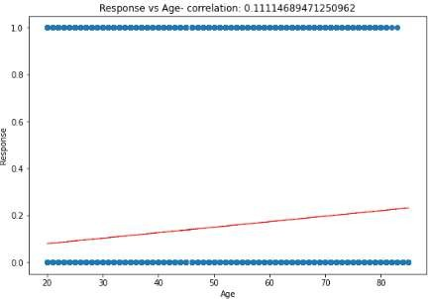
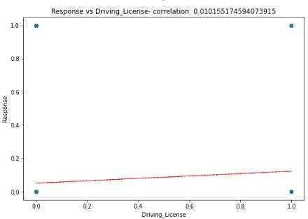
Statistical Data Analysis
Age and Response are positively co related.(Fig 22). And Driving license and Response
are positively co related.(Fig 23)
Fig 21: Co-relation plot of Age and Response.
Fig 22: Co-relation plot of Driving license and
Response.

Slide 26
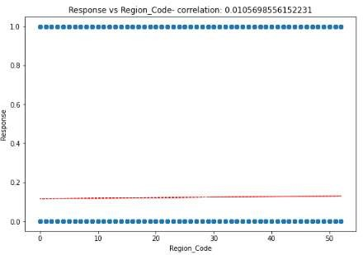
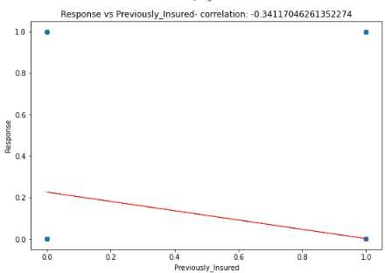
Statistical Data Analysis
Region code and Response have no co relation.(Fig 24) and Previously insured and
Response are negatively co related(Fig 25)
Fig 23: Co-relation plot of Region code and
Response.
Fig 24: Previously insured and Response.

Slide 27
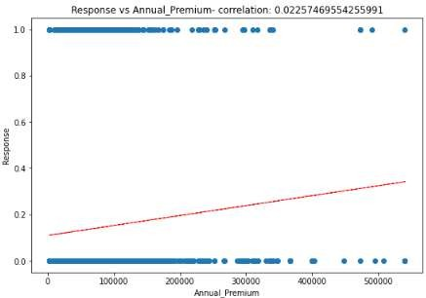
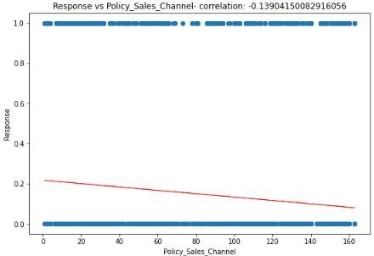
Statistical Data Analysis
Annual premium and Response are positively co related.(Fig 26) and Policy sales
channel and Response are negatively co related.(Fig 27)
Fig 25: Co-relation plot of Annual premium and
Response.
Fig 26: Co-relation plot Policy sales channel and
Response.

Slide 28
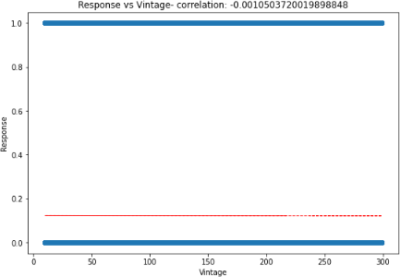
Statistical Data Analysis
Vintage and Response has no co relation.(Fig 28).
Fig 27: Co-relation plot of Vintage and Response.

Slide 29
Hypothesis Testing
With EDA we can justify our hypothesis.
Vehicle previously insured will affect reject.)
Response.(Fail to
Age will not affect Response.(Reject)
Driving license will not affect Response.(Reject)
There will be positive co relation in Vintage and Response.(Reject)
Vehicle damage will affect Response.(Fail to reject)

Slide 30
Model implementation
After implementing various models on the given data such as Logistic Regression, Decision Tree Classifier, XG boost, Naïve Bays Classifier, SGD Classifier, Cat Boost Classifier, KNN Classifier, Gradient Boosting Classifier, AdaBoost Classifier, Random Forest Classifier.
Model | Train | Test | Model | Train | Test
Logistic Regression | 0.76 | 0.59 | Cat Boost Classifier | 0.5 | 0.87
Decision Tree Classifier | 0.99 | 0.80 | KNN Classifier | 0.86 | 0.73
XG boost | 0.88 | 0.81 | Gradient Boosting Classifier | 0.82 | 0.72
Naïve Bays Classifier | 0.76 | 0.58 | AdaBoost Classifier | 0.81 | 0.70
SGD Classifier | 0.76 | 0.59 | Random Forest Classifier | 0.99 | 0.81
Table 1 Result table of models.

Slide 31
Model implementation
We get maximum accuracy with Decision Tree Classifier, Random Forest Classifier, XG boost but in case of Decision Tree and Random forest accuracy is decreased for testing data it is the case of Over fitting. In case of XG Boost accuracy decreases but with less percentage here there is no problem of overfitting.
Model | Train | Test
XG Boost | 0.88 | 0.81
Decision Tree Classifier | 0.99 | 0.80
Random Forest Classifier | 0.99 | 0.81
Table 2 Result table of Complex models.

Slide 32
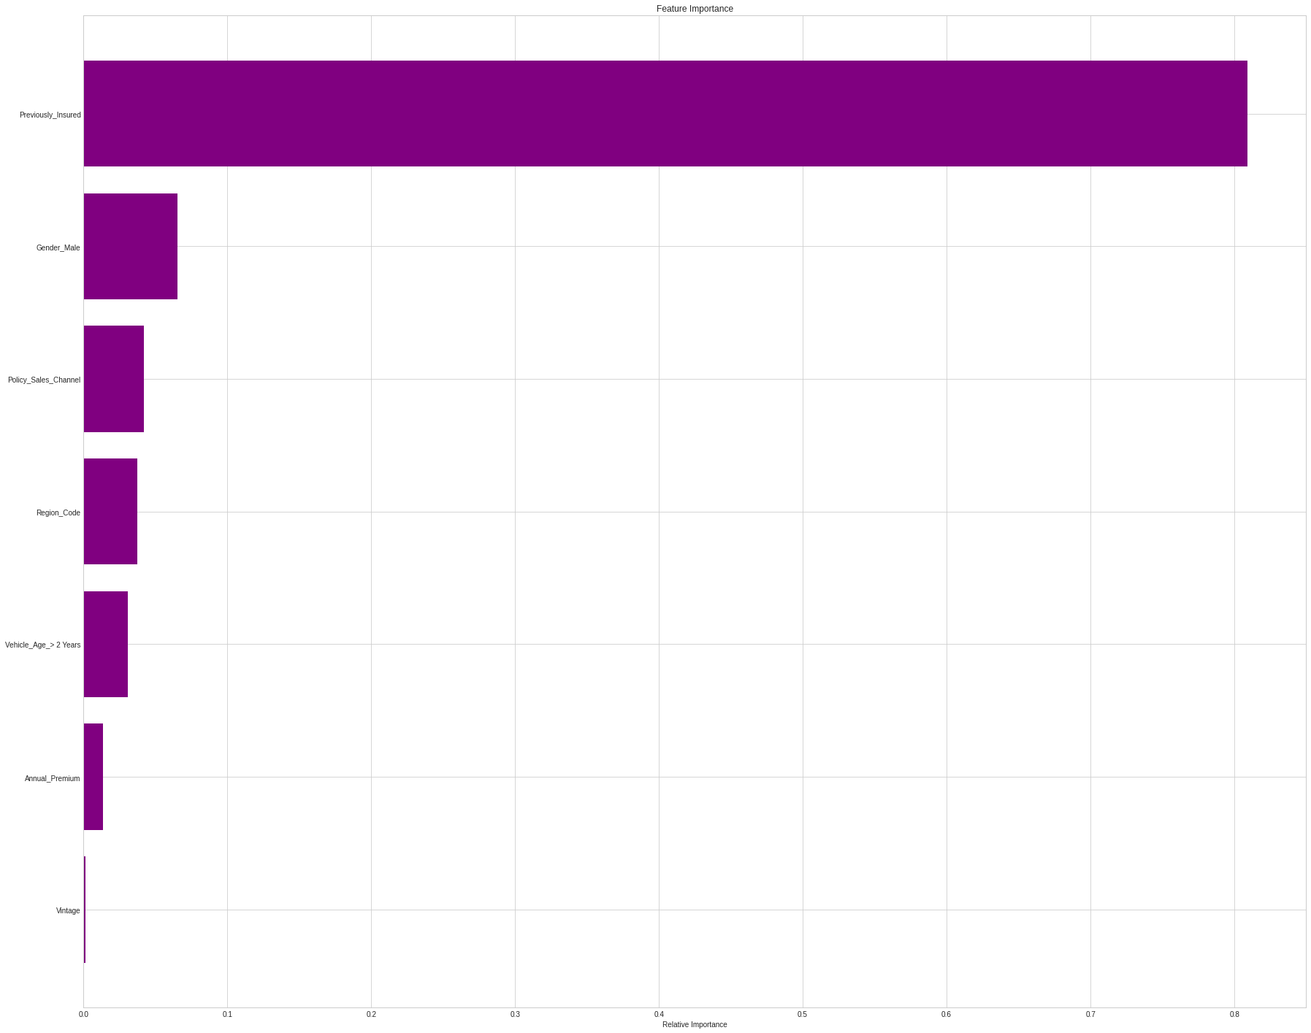
Model implementation
Previously insured
Gender male
Policy sales channel
Region code
Vehicle age > 2 years
Annual_Premium
Vintage
Fig 28: Feature importance graph From XG Boost.

Slide 33
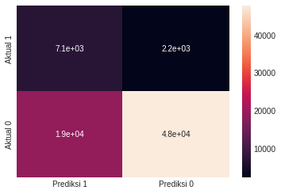
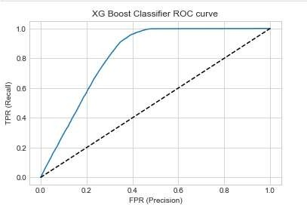

Model implementation
Fig 29: Heat map of confusion matrix.
Fig 30: XG Boost Classifier ROC Curve
Table 3: Values of Confusion matrix for XG Boost.

Slide 34
Conclusion
There will be more profit if company sells both health and vehicle
insurance.
Previously insured is important feature for cross sell.
After implementation of various models we got best results from Decision tree classifier, Random forest classifier and XG boost classifier.
Decision tree and Random forest are over fitting so finally we decide to go with XG boost.
XG boost with train accuracy as 0.88 and test accuracy of 0.81

Slide 35
References
“A Study on a car Insurance purchase Prediction Using Two-Class Logistic Regression and Two-Class Boosted Decision Tree” by Su Hyun AN1 , Seong Hee YEO2 , Minsoo KANG3
”A study on the meaning of automobile in the no insurance automobile
injury insurance” by Choi, B. G
”Cross-selling through database marketing: a mixed data factor analyzer
for data augmentation and prediction” by Wagner A. Kamakura

Slide 36
Thank You…

